Slide 1
Few Shot Learning
seasonsyang
2021/07/08

Slide 2
Contents
Introduction
Problem
Supervised Learning vs Meta Learning
Method
Open Dataset
Classic Methods
Related Methods
Our Research
Experiment
Hair Color
FuChi D54
Future
Notes:
1. 实验要说明每种方法在现有任务上的效果
2.

Slide 3
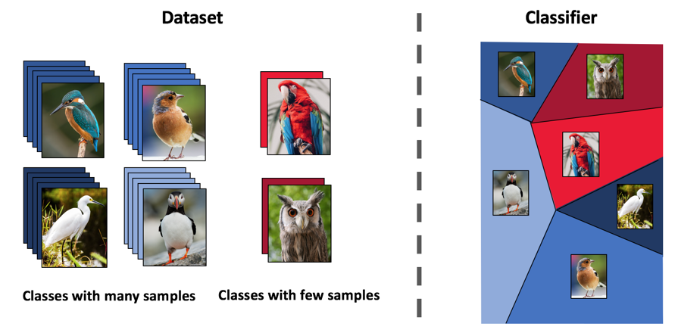
Introduction
Problem Description: Classification
Notes:
一言以避之 用大量有标注模型已知类别数据 去对拥有少量已标注的模型未知类别的数据进行分类
一直被问一个问题：多少张算few

Slide 4
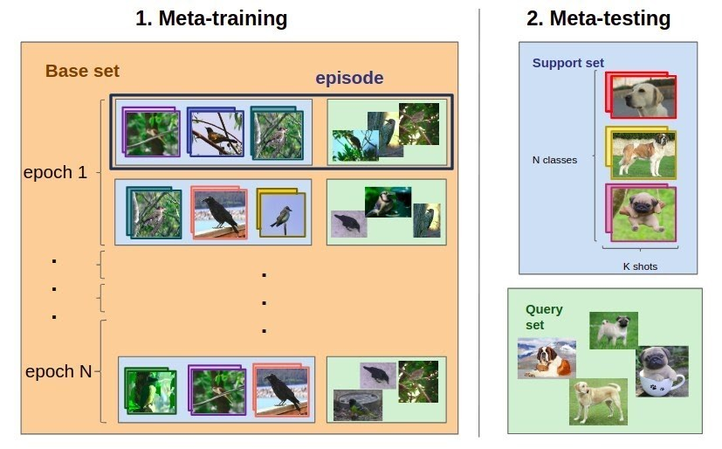
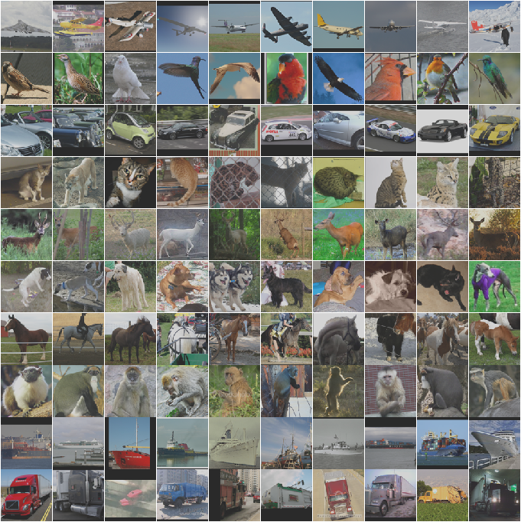
Introduction
Meta-Learning
Dataset Example
Notes:
N-way-K-shot 分类

Slide 5
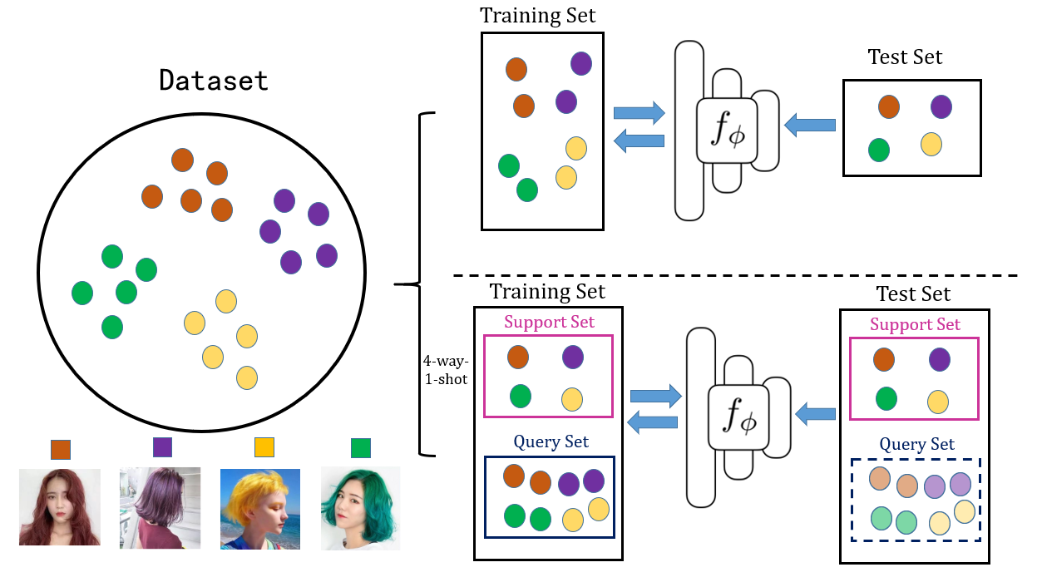
Introduction
Supervised Learning vs Meta-Learning
Notes:
Question : limitation/testing

Slide 6
Method
Open Dataset
name | description | number of images | number of class | image size
Omniglot | hand writing | 1623*20 | train: 1200 test/val: 423 | 28*28
miniImageNet | imageNet | 100*600 | train: 64 test: 20 val: 16 | 84*84
tieredImageNet | imageNet | 779165 | train: 20(351) test: 8(160) val: 6(97) | 84*84
CUB-200 | Caltech-UCSD Birds-200-2011 | 11788 | train: 100 test: 50 val: 50 | 84*84
CIFAR-FS | CIFAR100 Few-Shots | 100*600 | train: 64 test: 20 val: 16 | 32*32

Slide 7
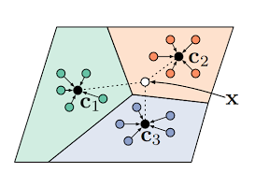
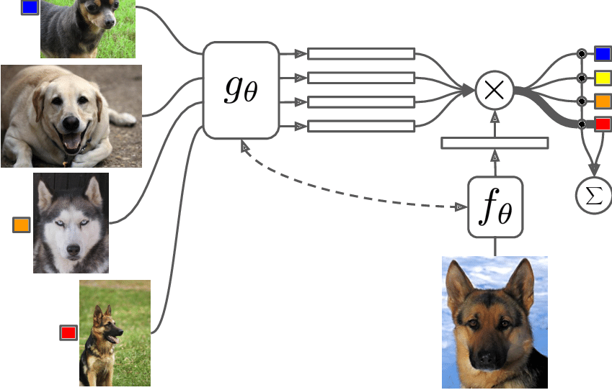
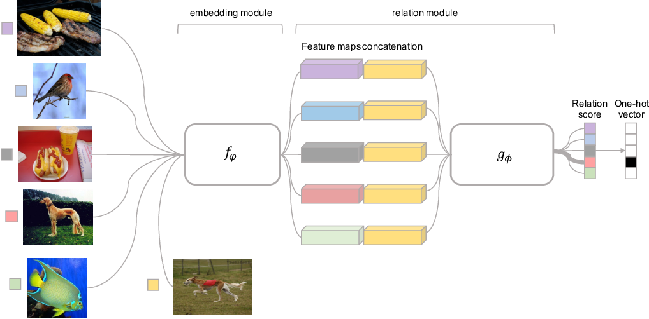
Method
Classic Few-Shot Learning Methods
Prototype Network
Matching Network
Relation Network
Notes:
Matching Net (cosine similarity)
Prototype Net (NN)
Relation Net (classifer)
Protonet

Slide 8
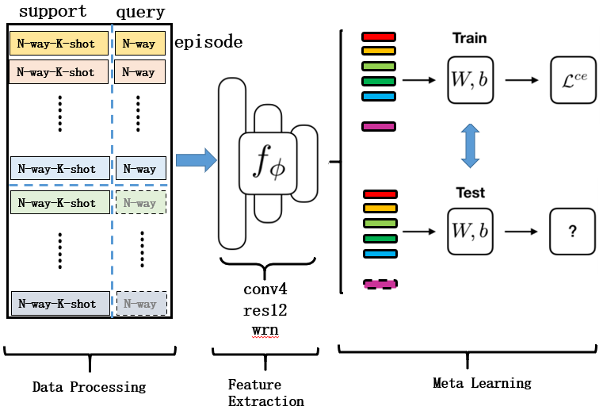
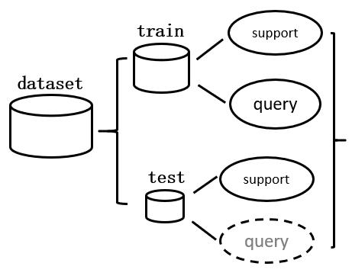
Method
Trend
Notes:
整体概览

Slide 9
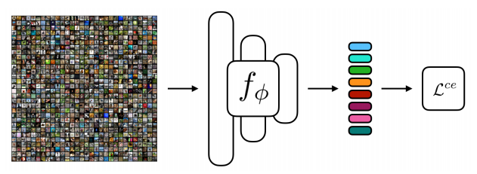
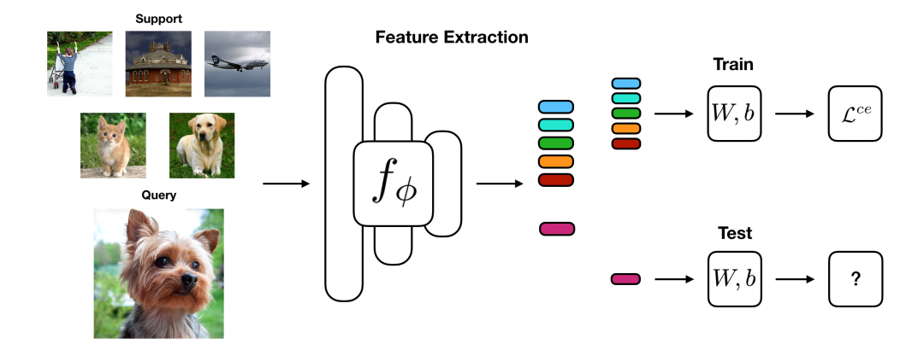
Method
Trend
Notes:
整体概览

Slide 10
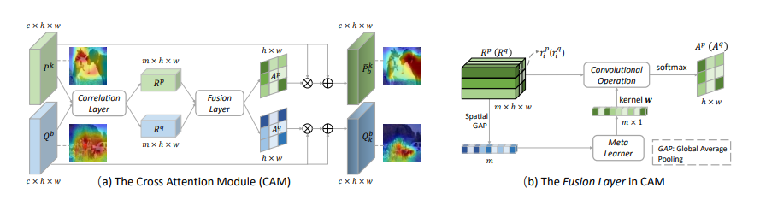
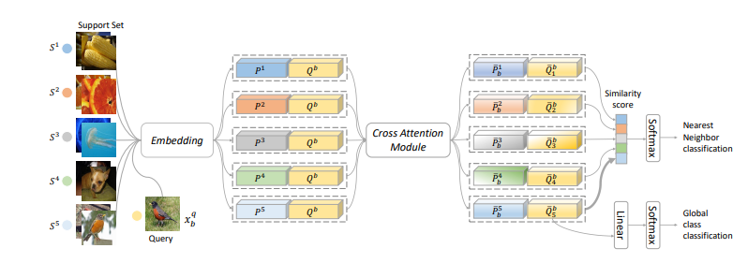
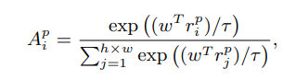
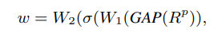
Method
Cross Attention Network for Few-shot Classification (NIPS2019)
Notes:
提出使用support和query之间的相关性去修正feature map

Slide 11
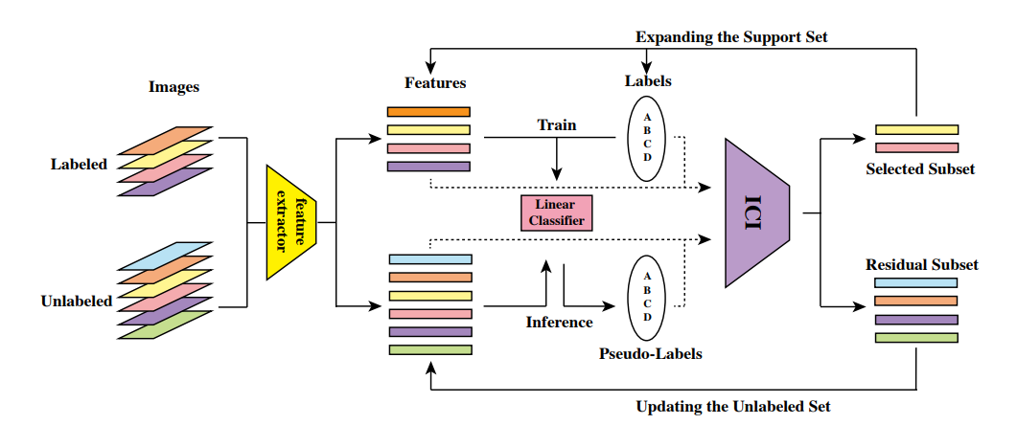
Method
ICI：Instance Credibility Inference for Few-Shot Learning (CVPR2020)
Notes:
给数据加上伪标签

Slide 12
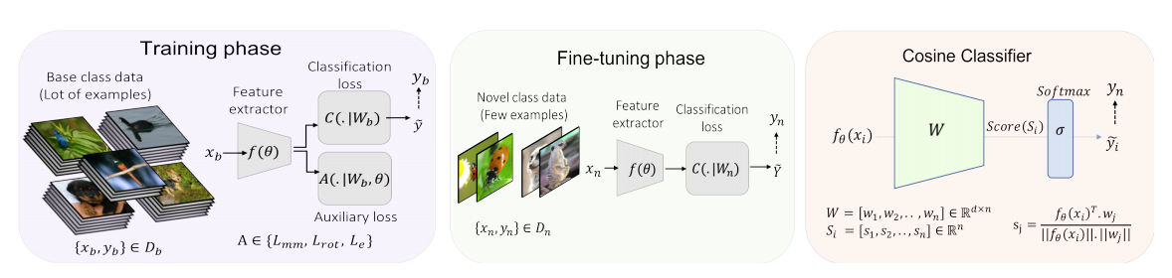
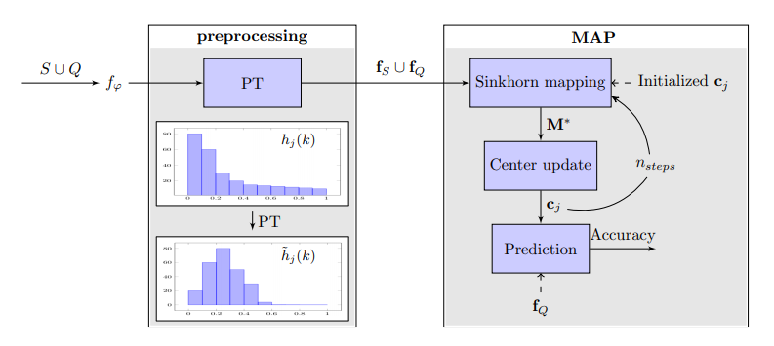
Method
Charting the Right Manifold: Manifold Mixup for Few-shot Learning (2020)
Leveraging the Feature Distribution in Transfer-based Few-Shot Learning (2020)

Slide 13
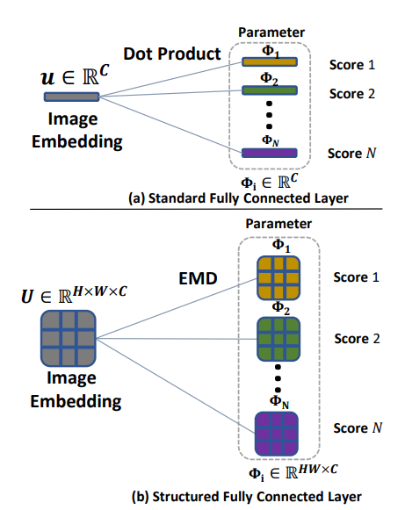
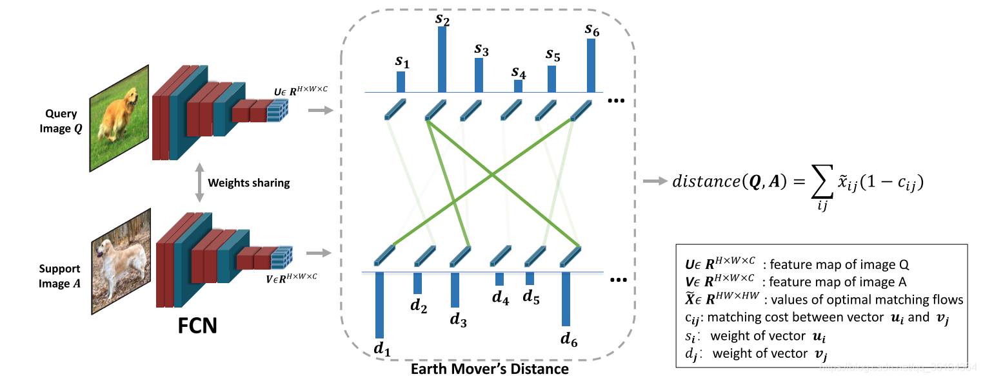
Method
DeepEMD: FewShot Image Classification with Differentiable Earth Mover’s Distance and Structured Classifiers (CVPR2020)
Notes:
我们首先介绍下EMD的计算过程，EMD的计算本身是来源于线性规划中的运输问题，假设有一系列的货源地S = { s i ∣ i = 1 , . . . , m } \mathcal{S}=\left \{s_i|i=1,...,m\right \}S={s i​ ∣i=1,...,m}和一系列的目的地D = { d j ∣ j = 1 , . . . , k } \mathcal{D}=\left \{d_j|j=1,...,k\right \}D={d j​ ∣j=1,...,k}，s i s_is i​ 和d j d_jd j​ 分别表示货源地i ii的货物供应量和目的地j jj的货物需求量，c i j c_{ij}c ij​ 表示两地之间的单位运输成本，x i j x_ijx i​ j表示两地之间的运输量，那么运输问题的目的就是寻找运输成本最低的运输方案X ~ = { x ~ i j ∣ i = 1 , . . . , m , j = 1 , . . . , k } \tilde{\mathcal{X}}=\left \{\tilde{x}_{ij}|i=1,...,m,j=1,...,k\right \} X~ ={ x~ ij​ ∣i=1,...,m,j=1,...,k}

Slide 14
Method
论文 | 年份 | 技术方法名称 | 数据集 | backbone | 论文指标 | 复现/重构指标
Learning to Compare: Relation Network for Few-Shot Learning | CVPR 2018 | RelationNet | miniImageNet | conv4 | 50.44 ± 0.82% | 50.50%
Cross Attention Network for Few-shot Classification | NIPS 2019 | CAN | miniImageNet | resnet12 | 63.85 ± 0.48% | 64.02 ± 0.20%
Instance credibility inference for few-shot learning | CVPR2020 | ICI | miniImageNet | resnet12 | 66.80% | 68.61%
Embedding Propagation：Smoother Manifold for Few-Shot Classification | ECCV2020 | EPNet | miniImageNet | conv4 WRN | 59.32 ± 0.89% 69.92 ± 0.81% | 54.04% 65.45%
LaplacianShot：Laplacian Regularized Few-Shot Learning | ICML 2020 | LaplacianShot | miniImageNet | WRN | 67.43% | 62.61 ± 0.18%
Rethinking Few-Shot Image Classification：a Good Embedding Is All You Need | ECCV2020 | RFS | miniImageNet | resnet12 | 64.82 ± 0.60% | 62.80 ± 0.8%
Deep-EMD Few-Shot Image Classification with Differentiable Earth Mover’s Distance and Structured Classifiers. | CVPR2020 | DeepEMD | miniImageNet | resnet12 | 68.77% | 67.96 ± 0.29%
PT-MAP：Leveraging the Feature Distribution in Transfer-based Few-Shot Learning | 2020 | PT-MAP | miniImageNet | WRN | 65.35 ± 0.20% | 68.66 ± 0.29%

Slide 15
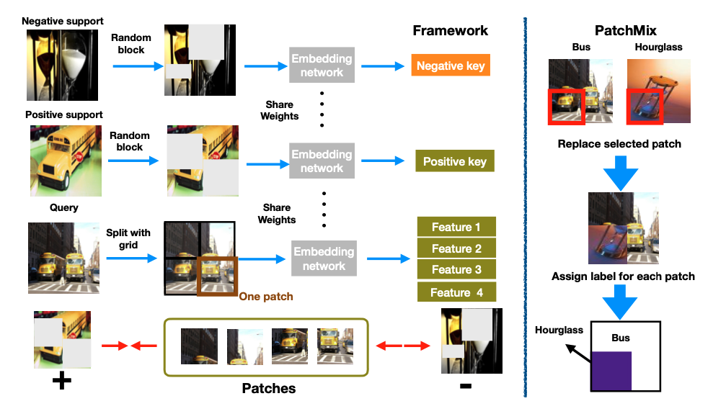
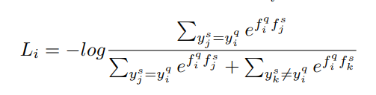
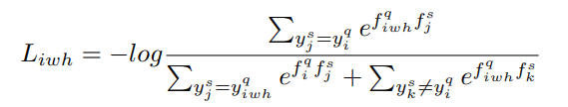
Method
Our Research: InfoPatch
Step3
Step1
Combine infoNCE loss
Step2
Construct hard samples

Slide 16
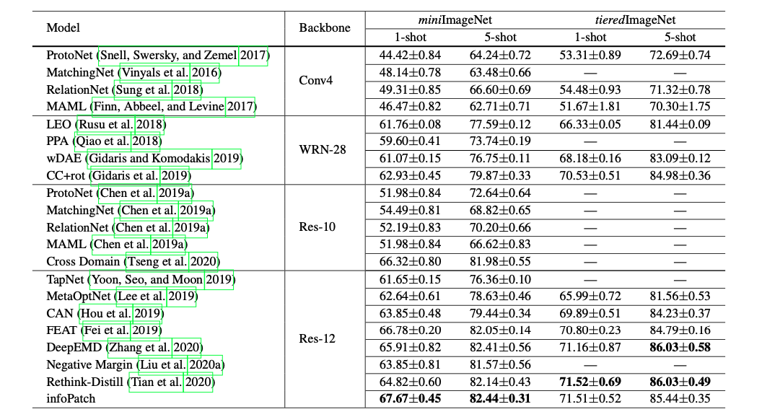
Method
Our Research: InfoPatch

Slide 17
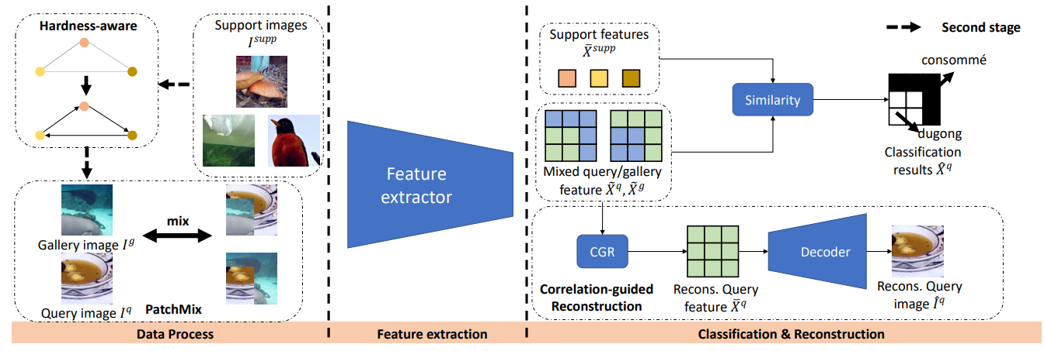
Method
Our Research: PatchMix

Slide 18
Method
Conclusion
Normal
Few-shot
Advantage
Advantage
Easy to follow
Friendly to unseen class
Drawback
Drawback
Need Large amounts of data
Hard to understand
Too many limitations (train/test)
Questions
How to find the relationship between theory and practice?
Can the few-shot methods work on many-shot case?
Notes:
1. 是否可以迁移
2.多少张图片适合meta-learning

Slide 19
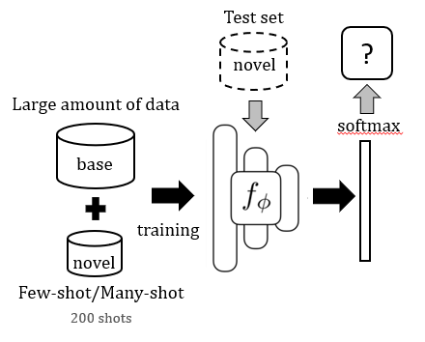
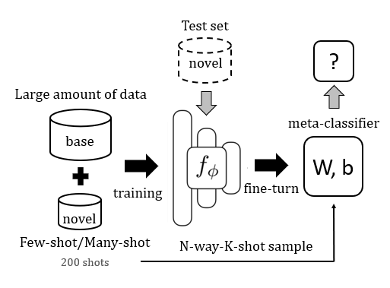
Experiment
Settings
Normal
Few-shot

Slide 20
Experiment
Results (HairColor)
Name | Dataset | Settings | backbone | Accuracy
normal_cls4 | HairColor | Images from only 4 few classes (200 each) | res18 | 97.78%
normal_cls8 | HairColor | Images from 8 classes | res18 | 98.16%
few-shot (PT-MAP) | HairColor | 4-way-200-shot | res18 | 99.33%
Shots | 1 | 5 | 10 | 50 | 100 | 200
Accuracy | 64.20% | 74.05% | 75.75% | 79.27% | 80.99% | 83.12%

Slide 21
Experiment
Results (FC-project)
Name | Dataset | Settings | backbone | Accuracy
normal_cls3 | FC | Images from only 3 few classes (200 each) | res18 | 69.50%
normal_cls12 | FC | Images from 12 classes | res18 | 85.50%
few-shot (PT-MAP) | FC | 3-way-200-shot | res18 | 90.00%

Slide 22
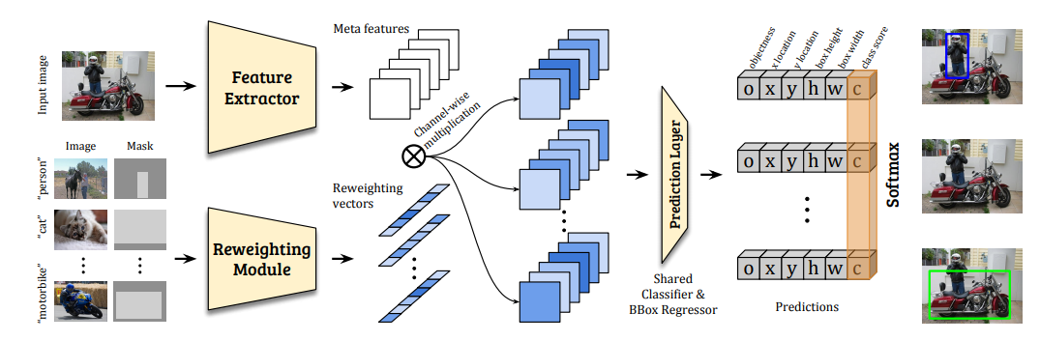
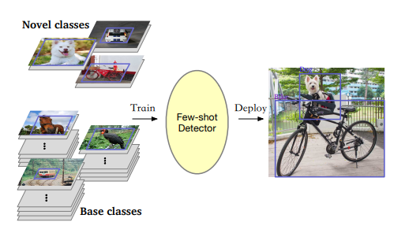
Future
Few Shot Learning for Object Detection

Slide 23
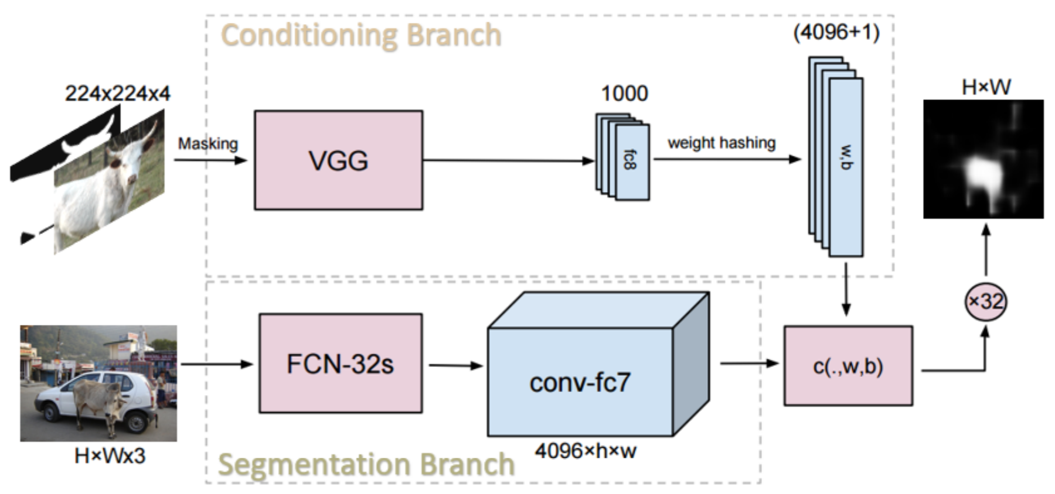
Future
Few Shot Learning for Semantic Segmentation

Slide 24
Thank You!

